Slide 1





The arrow of complexity
Miguel Brun-Usan PhD.
Dr. Richard Watson’ s group
E.C.S. University of Southampton

Slide 2
Arrow of complexity
Big question: does evolution naturally tend to increase the complexity of evolved things?
For: life on earth is more complex now than it was originally (esp before life), and evolution is the only process capable of creating that complexity, so evolution manifestly has increased the complexity of evolved things.

Slide 3
Arrow of complexity
Big question: does evolution naturally tend to increase the complexity of evolved things?
For: life on earth is more complex now than it was originally (esp before life), and evolution is the only process capable of creating that complexity, so evolution manifestly has increased the complexity of evolved things.
Against: evolution by natural selection promotes proliferation of whatever reproduces fastest – that’s all. Often the things that reproduce most effectively are not complex – e.g. parasites in Tierra, smaller loops in evoloop, bacteria/viruses on Earth. There is no inherent tendency for evolution to increase complexity, the existence of some complex organisms on Earth is not sufficient to expect this to be a trend in evolution. STEADY STATE since CAMBRIAN.

Slide 4
Overview
How to measure complexity?
Has complexity increased?
Is there a ‘generic trend’ for increase?
If yes, do we understand the mechanism?
-How development generates complexity
-How natural selection “sees” complexity
What might be missing?
  Major transitions in evolution

Slide 5
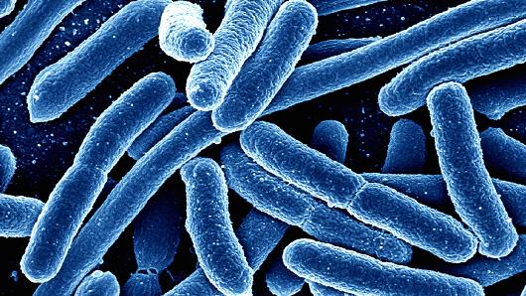
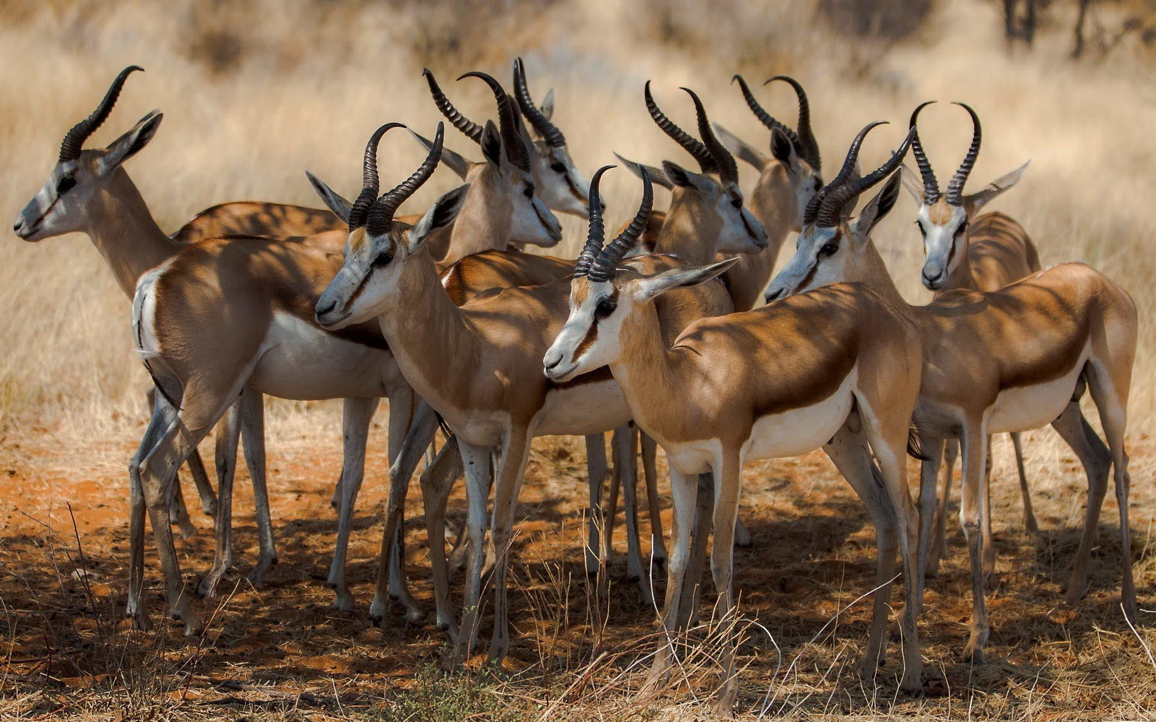
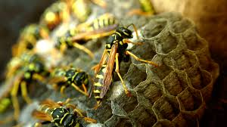
How to measure complexity
What is it?
  Size, number of parts, amount of DNA?
Information theoretic concepts
  Entropy, randomness vs order
Komolgorov complexity
Structural concepts
  Number of different parts, types of different parts, types of interactions
<
?

Slide 6
Information theoretic complexity: Shannon entropy
Information entropy (Shannon)= how much information there is in a signal (fair coin= 1 bit per toss, double-headed coin=0 bits per toss)
(2nd law of thermodynamics, spontaneous increase in entropy: order → disorder)
Predictable-ordered = low entropy ; Unpredictable-Disordered = high entropy
000000101010100000000000010100000101000000010010001000100010010110010101010010101010010010000000000000000000000000110000111000110000110001000000000000011001000011010011000110000
110100010111001011011000101111111010001111010111001011001011010101101101110001001000011000111101000110011100111101101001000101000101001111011110011000100011111110010110010000011111
ARECIBO MESSAGEy
RANDOM.org bite generator

Slide 7
Komolgorov complexity
The length of the shortest program (for universal Turing machine) that could generate it
Problems?
  Kolmolgorov complexity maximised by randomness
  Kolmolgorov generally incomputable (As McShea puts it “what is the length of the shortest algorithm that will generate an actual rain forest?”)
  There is no proof for minimal length.
  Program to produce π is quite short, is π simple?

Slide 8
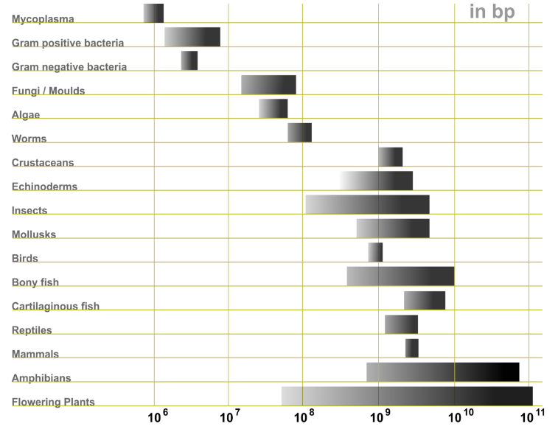
Komolgorov complexity
The length of the shortest program (for universal Turing machine) that could generate it. Logical depth.
Problems? Programs of different complexity generate the same output. NS only “sees” the output, not the program itself. No force to shorten the length of the program.
  If we consider DNA as the “program”: C-value paradox.

Slide 9
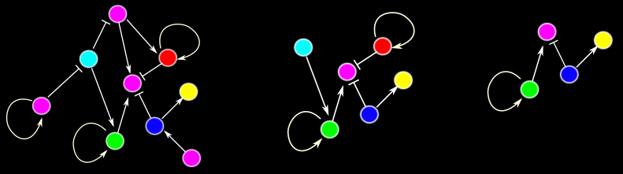
Komolgorov complexity
The length of the shortest program (for universal Turing machine) that could generate it. Logical depth.
Problems? Programs of different complexity generate the same output. NS only “sees” the output, not the program itself. No force to shorten the length of the program
  If we consider development (GRNs) as the “program”: Developmental systems drift.
Phenotype A

Slide 10
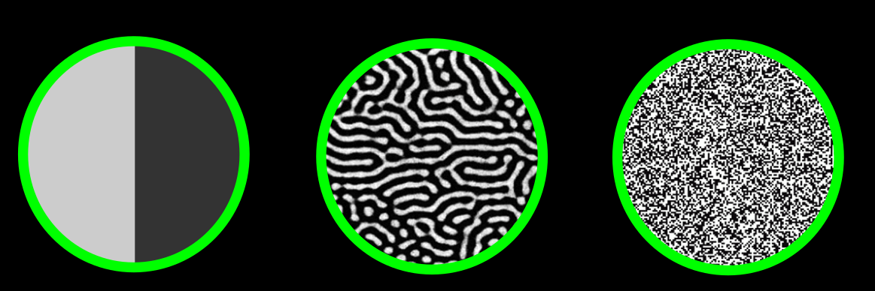
Problems with Komolgorov and Entropy
Rough measures, maximized by randomness
Niether Komolgorov complexity nor Shannon entropy maximise ‘pattern’ or ‘structure’ or ‘organisation’
(http://cse.ucdavis.edu/~cmg/compmech/tutorials//ComplexityMeasures.pdf)
Structural complexity
Totally ordered
entropy
Totally random

Slide 11
Modern approaches
Epsilon machines (Jim Crutchfield); state machines with probabilistic transitions
size of machine=complexity
Using probabilistic transitions (rather than deterministic), an e-machine that simulates random coin tosses is a small machine → low complexity
i.e. A random string is NOT complex in this measure
(finding minimal e-machine still incomputable though)

Slide 12
Less theoretic notions of complexity
e.g. structural complexity
Number of different parts; types of parts or interactions

Slide 13
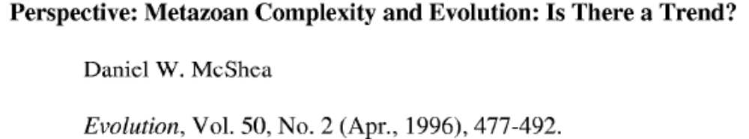
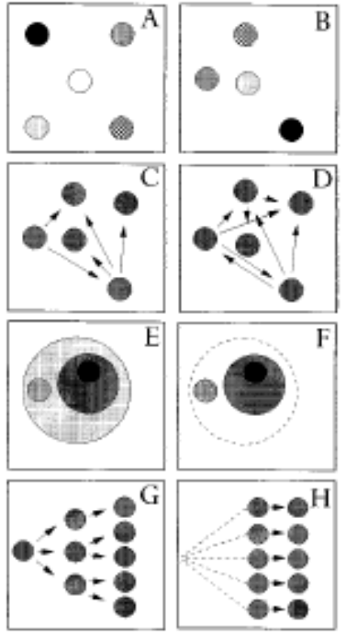
4 types of complexity, Mc Shea
Object vs process
Hierarchical vs non-hierarchical
(non-hierarchical) Object complexity
(non-hierarchical) Process complexity
Hierarchical object complexity
Hierarchical process complexity

Slide 14
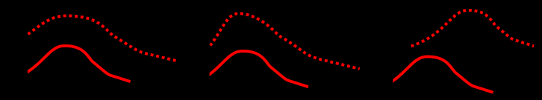
Has complexity of life on earth increased?
Consider: Non-living molecules → protocells → bacteria → eukaryotic cells → multicellularity → complicated multi-cellular organisms with brains and language
But there’s still an awful lot of bacteria !!
Certainly the complexity of the most complex thing has increased, but the mean complexity maybe has not increased too much …
Result of ‘passive diffusion’ (increase in complexity not adaptive)?
TIME
COMPLEXITY

Slide 15
Trends
Trend: An observable increase or decrease in a measured quantity
Generic trend: robust regularity in trend (repeatable, like a ‘law’, not accidental)
Mechanism: explains a generic trend
Example 1. stocks:
  Trends: ‘black Monday 1987’ stable trend becomes rapid falling trend
  Generic trends: boom and crash cycle happens repeatedly/ is bound to happen
  Mechanism: positive feedback in trading price increases creates artificially inflated prices with no ‘real’ value underlying them …

Slide 16
Example 2: complexity of life on Earth
  Trend: complexity of life on earth has increased
  Generic trend?: could be
  Mechanism: Evolution, IFF complexity was adaptive
But, we don’t know if the trend in increasing complexity is a generic trend (we only have one sample).
Because we don’t know how complexity is generated thorogh developmental processes.
Nor we do not know whether the generated complexity is adaptive or not!

Slide 17
Some opinions
Darwin: “from [evolution by natural selection] the production of higher animals directly follows”
Dennett: complexity increase is “forced move”
Stephen Jay Gould: its all ‘historical contingency’ (accidental) – passive diffusion (McShea 1994) at most
John Maynard Smith: no expectation of increased complexity from natural selection
Stuart Kauffman: there is a generic trend, but the mechanism is self-organisation
Mark Bedau: this is all rhetoric, if you think you know a mechanism, show me the model that exhibits the generic trend. We havn’t seen one yet!

Slide 18
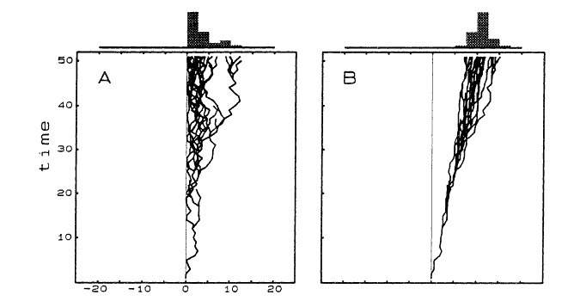
Passive diffusion model, McShea 1994
passive
driven
The problem is, is that x-axis a reasonable dimension?
consider ‘number of wheels’ or ‘number of pink stripes’.

Slide 19
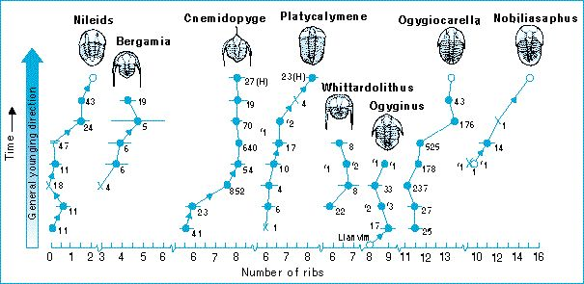
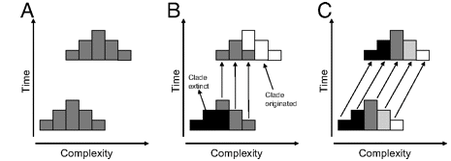
Passive diffusion model, McShea 1994
passive
driven
-It has to occur in parallel lineages (not extinction-driven)
A. Trend. B. Extinction-driven. C. Consistent.
Adamowicz, Sarah J., Andy Purvis, and Matthew A. Wills. "Increasing morphological complexity in multiple parallel lineages of the Crustacea." Proceedings of the National Academy of Sciences 105.12 (2008): 4786-4791.

Slide 20
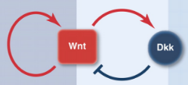
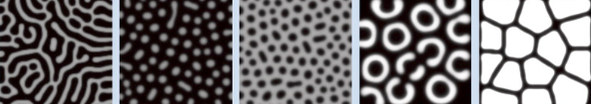
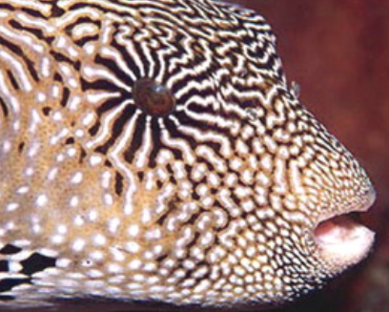
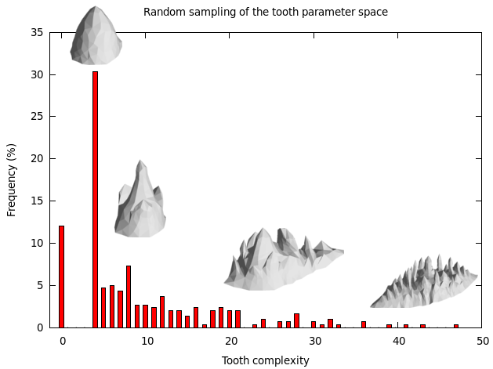
EVOLUTIONARY CHANGE=
How non-random variation is produced from random mutations (development) +
How natural selection arising from ecological interactions filters out this variation …
Simple (emergent, easy to airse) GRNs can produce complex and disparate phenotypes. Less gradual transitions. Example: Turing R-D systems.
The complexity produced under a given developmental mechanism is often biased.
Up: Kondo, S., Miura, T. 2010. Reaction-Diffusion Model as a Framework for Understanding Biological Pattern Formation. Science 329; 5999(1616-1620) Bottom: Salazar-Ciudad, I., Marin-Riera, M. 2013. Adaptive dynamics under development-based genotype-phenotype maps. Nature 497.7449: 361-364.

Slide 21
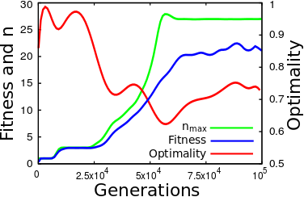
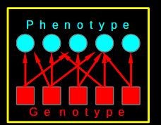
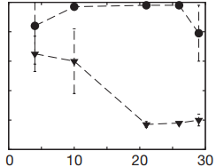
EVOLUTIONARY CHANGE=
How non-random variation is produced from random mutations (development) +
How natural selection arising from ecological interactions filters out this variation …
Complexity catastrophe: NS can not optimize all traits simultaneously.
Rugged landscapes: NS can not optimize all traits independently.
Brun‐Usan, M., M. Marin‐Riera, and I. Salazar‐Ciudad. "On the effect of phenotypic dimensionality on adaptation and optimality." Journal of evolutionary biology 27.12 (2014): 2614-2628.
FITNESS
GPM-complexity

Slide 22
Bedau on Tierra
For example, maybe you think the following properties are sufficient for a system to show generic trend to increasing complexity
  natural selection
  implicit fitness
  infinite genetic space
  computational universality
Tierra has all these things, but the results do not exhibit generic trend to increasing complexity.
If Ray didn’t implement these things ‘correctly’ in Tierra, then our definition of these features is incomplete

Slide 23
Some extra magic ingredient?
Open endedness
Hierarchical structure
The major transitions in evolution, Maynard Smith and Szathmary
  Self-replicating molecules → chromosomes
  Proto-cells → cells
  Prokaryote cells → Eukaryote cells
  Single celled organisms → multicellular organisms
  Asexual populations → sexual populations
  Homogeneous populations → eusocial colonies
“entities that were capable of independent replication before the transition can replicate only as part of a larger whole after the transition”

Slide 24
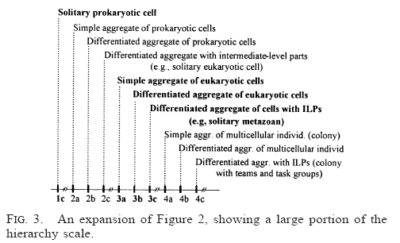
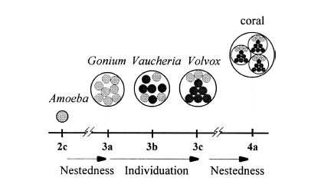
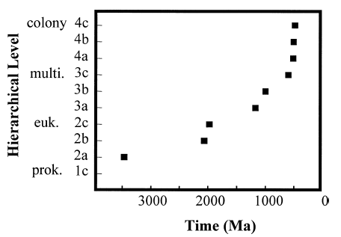
Hierarchical Evolution, McShea and Changizi, 2003
Hierarchical composition
degree of individuation
a) monomorphic aggregate,
b) differentiated aggregate,
c) (b)+intermediate level parts
NB. The paper is actually about some problems in this apparently neat trend

Slide 25
Hierarchical evolution
It’s an enticing observation about natural evolution
Maybe it is a generic trend
Probably, evolution by natural selection is not a sufficient mechanism
In any case ...
  GET are not properly adressed by the current neodarwinian view of biological evolution
  No-one has demonstrated generic trend for hierarchical complexity in an evolutionary model/Alife model

Slide 26
‘odious allies’
Development natural selection explain part of the organismal complexity
But “dishonest to deny that evolutionary creativity is an open question, a mystery.” Bedau.
Evolutionary creativity is an open question ≠ supernatural explanation required.
If increase in complexity is a generic trend, what is the mechanism that produces it? If it is evolution by natural selection (which is surely involved), what is missing from current artificial examples?
What are the mechanisms that are missing in our understanding? (e.g. rich physical environment, coevolution, self-organisation, dynamical systems theory, mechanisms of encapsulation, hierarchy, changes in the unit of selection)

Slide 27
Summary
Measuring complexity is challenging: Kolmogorov and Shannon not wholly satisfying. Structural complexity.
McShea’s passive diffusion model may be a generic trend for increase in complexity at large scale.
At smaller scales, increases/decreases in complexity are not produced with the same likelihood by development.
Natural selection “sees” simple and complex morphologies differently.
Changes in complexity may be adaptive in some instances.
Hierarchical complexity is probably a keystone for further studies in biological complexity.

